Slide 1
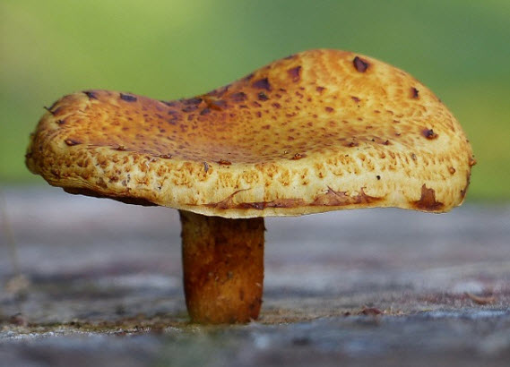
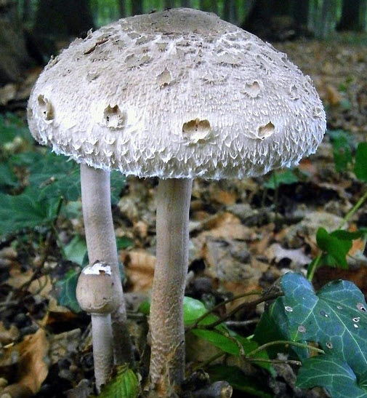
Solution 2: Fungi

Slide 2
Step 1: Coming Soon!

